Slide 1
Grayson College Campus Security Authority Training
Presented by:
Grayson College Police Department

Slide 2
The Disclosure of campus security policy & crime statistics act
What You Need to Know if You Are a “Campus Security Authority”

Slide 3

The Clery Act
Jeanne Clery was raped and murdered in her dorm room at Lehigh University in 1986. Her killer was another student. Her parents believe she would have been more cautious if she had known about other violent crimes at Lehigh.
Congress Agreed

Slide 4
The Clery Act
The Jeanne Clery Disclosure of Campus Security Policy and Campus Crime Statistics Act (Clery Act) was enacted in her memory.
It was first enacted in 1990 and amended in 1998. It requires institutions of higher education who are receiving federal financial aid, to report specific crime statistics on campus to current & prospective students and employees.

Slide 5
The Clery Act
The goal of the Clery Act is to ensure that students, prospective students, parents, and employees have access to accurate information about crimes committed on campus, and campus security procedures.
Information disclosed under the Clery Act can assist students and parents in making decisions which affect their personal safety.

Slide 6
The Clery Act
Requirements of the Clery Act:
Disclose, collect, classify and count crime reports and statistics
Issue Crime Alerts - timely warning for any Clery Act-specified crime that represents an ongoing threat to the safety of students or employees
Issue Emergency Notifications upon confirmation of significant emergency or dangerous situation involving immediate threat to health or safety

Slide 7
The Clery Act
Requirements of the Clery Act (continued):
Publish an Annual Security Report
Submit Crime Statistics to Department of Education
Maintain a daily crime log that is publicly available
Implement missing student notification procedures
Maintain Fire Safety information - including fire log, annual fire report with statistics, and policy statements

Slide 8
Why am I involved?
Many crimes and incidents, especially sexual assaults, are not reported to the police.
To ensure that students know about dangers on campuses, the Clery Act requires institutions to gather and publish data from additional Campus Security Authorities.
That’s where you come in

Slide 9
What makes me a Campus Security Authority?
Four categories (or persons) of a CSA:
  Campus Police Departments
  Individuals with campus security responsibilities
  Individuals designated by the campus
  Officials with significant responsibility for Student and Campus Activities who are LIKELY to receive complaints from a victim of crime

Slide 10
Category 1: Campus Police Departments
All Officers of the Grayson College Police Department
All non-commissioned Public Safety Officers employed by Grayson College

Slide 11
Category 2: Individuals with Campus Security Responsibilities
Persons responsible for monitoring or controlling entrance to campus property
Special events security staff

Slide 12
Category 3: Individuals Designated by Grayson College
President’s Office and staff
Vice President of Student Services and staff
Ombudsman
Administrators over separate campuses such as the South Campus

Slide 13
Category 4: Officials with Significant Responsibility for Student & Campus Activities
Significant contact with students
Examples include:
  Housing Coordinator/Resident Assistant (RA)
  Student Judicial officers/Conduct Officer
  Directors or Managers of Student Life facilities
  Officials who oversee extracurricular activities
  Director of Athletics, Coaches and staff
  Faculty Advisors and Advisors to Student Groups
  Study Abroad Coordinators

Slide 14
CSA’s Primary Responsibility is:
To report allegations made in good faith to the reporting structure established by the institution.
  Good faith means there is a reasonable basis for believing that the information is not simply rumor or hearsay. That is, there is little or no reason to doubt the validity of the information.

Slide 15
You DO NOT have to report if:
You are a licensed mental health counselor or a pastoral counselor (employed by a religious organization to provide confidential counseling)
AND
You are working within the scope of your license or religious assignment

Slide 16
Confidential Reporting
Even if you are exempt and don’t have to report, you can tell the person how he/she can report the crime anonymously to Police.
You have to make a judgment call: Is it appropriate to mention Police in this particular situation?

Slide 17
My Job
I’m a Campus Security Authority and I’m not a counselor—What do I have to do?
  If someone tells you about a crime or an incident that may be a crime, you must record the information and submit it to the Grayson College Police Department immediately.
    Just get the facts, the Police will investigate and tabulate appropriate statistics.

Slide 18
What do I have to do?
When in Doubt…… REPORT

Slide 19
What Crimes must I report?
The 9 Clery Crimes are:
  Criminal Homicide
  Sex Offenses:
    Forcible and non-forcible
  Robbery
  Aggravated Assault
  Burglary
  Motor vehicle theft
  Arson
  Arrests & disciplinary referrals for violations of:
    Liquor
    Drugs
    Weapons
  Hate Crimes

Slide 20
What Crimes must I report?
In March 2013, President Obama signed a bill that strengthened the Violence Against Women Act (VAWA). Included in the bill was the Campus Sexual Violence Elimination Act (Campus SaVE) that amends the Clery Act to include reporting of the following effective 2014:
*Dating Violence *Domestic Violence *Stalking

Slide 21
What Crimes must I report?
These 3 new Clery crimes must be tracked for inclusion in the reporting of Clery Crime Statistics starting with the October 2014 Annual Security Reports.
The Annual Security Report must also include updated policy statements to include VAWA requirements addressing Sexual Harassment Policy and Procedures for Responding to Complaints of Sexual Harassment.

Slide 22
Timing is (almost) everything!
Be sure you can document:
  When did the crime or incident occur?
  When did the person report it you?

Slide 23
Location, Location, Location
You must report if it occurred:
  On Campus (including property owned on the West Extension)
  On public property adjacent to campus (Hwy 691 in front of the campus)
  On non-campus property owned or controlled by the College or a recognized student organization (mainly pertains to Greek Housing)

Slide 24
Applicability
Do NOT Report Crimes As a CSA if:
  A person tells you about a crime that occurred before he/she came to Grayson College
  OR
  While he/she was away from the campus and not involved in a College Sponsored activity (e.g., at home, on spring break, etc.)

Slide 25
Just get the facts!
Police will categorize the report: your job is to get the information the person wants to report.
You don’t need to be a detective.
You don’t have to prove what happened or who was at fault. You are NOT responsible for determining whether or not the crime took place before reporting it.
You aren’t supposed to find the perpetrator.
Do NOT identify the victim in the CSA report (you may identify them to the police IF the victim is agreeable)

Slide 26
Just the facts!
Let the person know about options for reporting to Police
Tell the person how he/she can report anonymously to Police by calling 903-463-8777.
A person who talks to you, may not want to talk to the Police -- and doesn’t have to. It’s their choice.

Slide 27
Offer Help
Provide the person with information on:
  Reporting to Campus Police or other jurisdiction
  Campus programs for assisting victims of sexual assault is available through Counseling Services
  Procedures for seeking medical help
  Outside resources:
    Crisis Center

Slide 28
Completing the Report
Compete the CSA Crime Reporting Form of the Sex Offenses Reporting Form
  You may need to wait until the person leaves
Tell the person you must report the incident as an anonymous statistic, but that you will NOT identify anyone involved.

Slide 29
What information to obtain
Description of the incident of the crime
  Where did it occur?
  When did it occur?
  What specifically happened?
Get as accurate and complete of a description of what happened as you can
If not sure; report what you have
Timely reporting is critical!!

Slide 30
Find out the Following in all cases
Is the victim and/or assailant a student? Are they acquaintances?
Does the victim wish to remain anonymous?
Has the incident been reported to police or to any other CSA?
Was either party under the influence of alcohol or drugs?
Notes:
Last question is for reporting purposes only. Even if victim of sexual assault was under the influence, they can still press charges!!

Slide 31
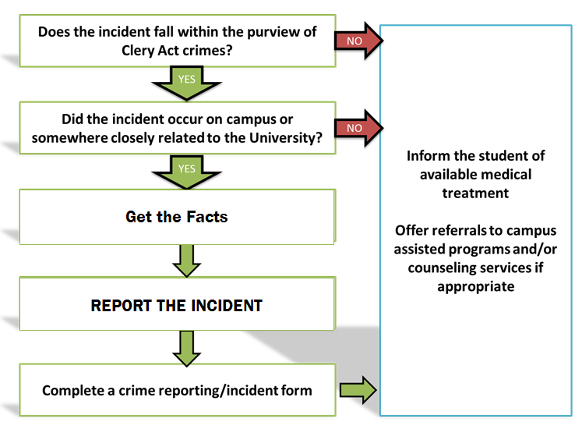
Review
Does the incident fall within the purview of Clery Act crimes?
Did the incident occur on campus or somewhere closely relate to the College?
Get the Facts
Complete a crime reporting/incident form

Slide 32
Key things to know
Homicide (someone has been killed)
  Who? Where? What? When? And How?
  Is a violent situation still in progress?
  Call Police Immediately!

Slide 33
Key things to know
Sex Offenses
  Is victim in danger?
  Did assailant use or threaten force? A weapon?
  Did assailant penetrate the victim’s body?
  Did victim consent?
  Did victim know assailant?
  Was victim unable to consent because of drugs or alcohol?
  Was victim a minor (younger than 18)?
Notes:
For consent, was consent given at the beginning then assailant was told to stop? If he/she did not stop, it is still an offense. Consent can be revoked at ANY time!

Slide 34
Key things to know
Robbery, Burglary, Theft (something was stolen)
  What was taken or attempted to be taken?
  What is its value?
  Did the suspect accost the victim? If yes…
    Did the perpetrator use or threaten force? A weapon? What kind?
    Was the victim injured?
    Did the victim feel threatened or in danger?

Slide 35
Key things to know
Robbery, Burglary, Theft (continued)
  If the perpetrator did not accost the victim…
    Was the item taken from inside a residence, dorm room, or office?
    Was the door open, closed, or locked?
    How did the thief get in?
    Time of day the theft occurred (day or night).

Slide 36
Key things to know
Motor Vehicle Theft
  What kind of vehicle?
  Where was it taken from?
  When was it taken?
  Has it been recovered?
  Does the person know who did it?
  “Joyriding” is a motor vehicle theft if the vehicle is taken by a person without lawful access

Slide 37
Key things to know
Arson (something intentionally set on fire)
  What was burned or attempted to be burned?
  Was anyone hurt?
  Was property damaged? How much?
  When did it happen?
  When was it discovered?
  Was there graffiti or other evidence of hate motivation?

Slide 38
Hate Crimes
Any of the nine reportable Clery Crimes that:
  Are done because of the victims race, gender, sexual orientation, ethnic background, or religious beliefs
  Things to note include:
    Were racial slurs used in threat or during attack
    Was there graffiti suggesting a hate motivation
    Was the target personal property of business, organization, house of worship that fits into the above categories

Slide 39
Liquor, drugs, weapons law violations
Police must keep statistics on the number of people arrested for liquor and drug law violations and illegal weapons possession.
Student housing must keep statistics on the number of students referred for disciplinary action due to liquor, drugs, and weapons violations.
  Disciplinary referrals should not include incidents in which the person is also arrested for the same offense (by campus police).
Statistics must reflect total number of persons involved, not incidents.

Slide 40
REMEMBER!!!!
WHEN IN DOUBT
REPORT!!

